Slide 1
KR Mangalam open source expo 2023
HACKATHON PROJECT
HMS(HOTEL MANAGEMET SYSTEM )
Made By :- YATHARTH CHOPRA

Slide 2
INTRODUCTION
• We have tried our best to make the complicated process of Design and Development of Hotel Management System as simple as possible using Structured & Modular technique & Menu oriented interface.

Slide 3
BUSINESS MODEL
HMS OR Hotel Management system will be yearly charged professional management software like GuestPoint and eviivo
Deference between them and my software is that it is less automated not cloud based but its easy to use and can be modified for the customer hotel need.

Slide 4
Purpose
The main purpose of my exercise is perform each Employee's activity in computerized way rather than manually which is time consuming.
The entire activity is to automate the process of day to day activities of Hotel like
Room activities very safely,
Assign a room according to customer's checkout of a computer and
Releasing the room and finally compute the bill in short time.

Slide 5
Software requirements
System development software Operating system: Windows 11
Development platform: VS CODE,PYTHON IDLE
Language: Python, MySql
User required software:
• Operating system: Windows7, 8,10
• MYSQL,PYTHON IDLE OR VS CODE

Slide 6
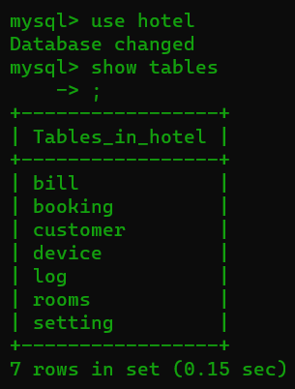
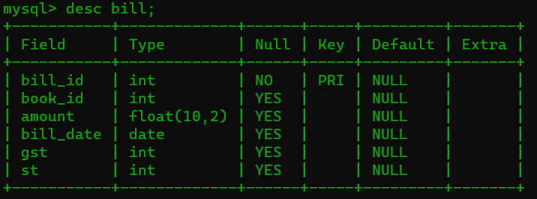
Backend Details
Database Name : hotel Code :
create database hotel;
use hotel;
Tables in hotel :
Tables bill:

Slide 7
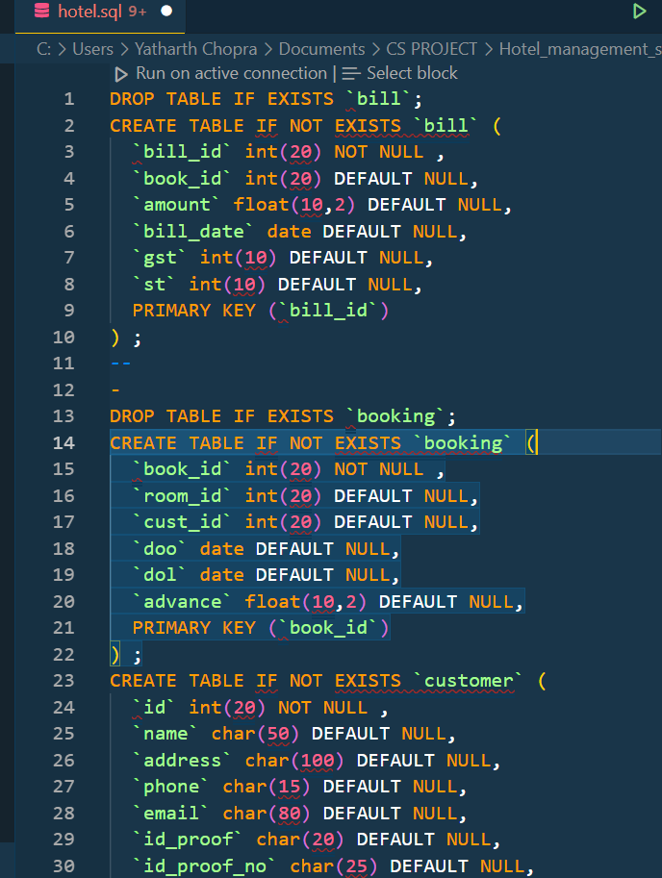
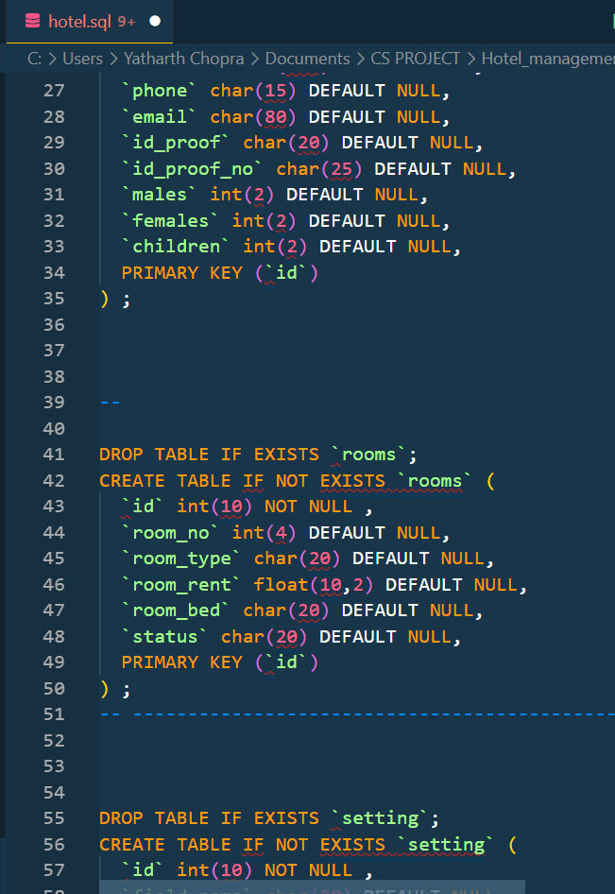
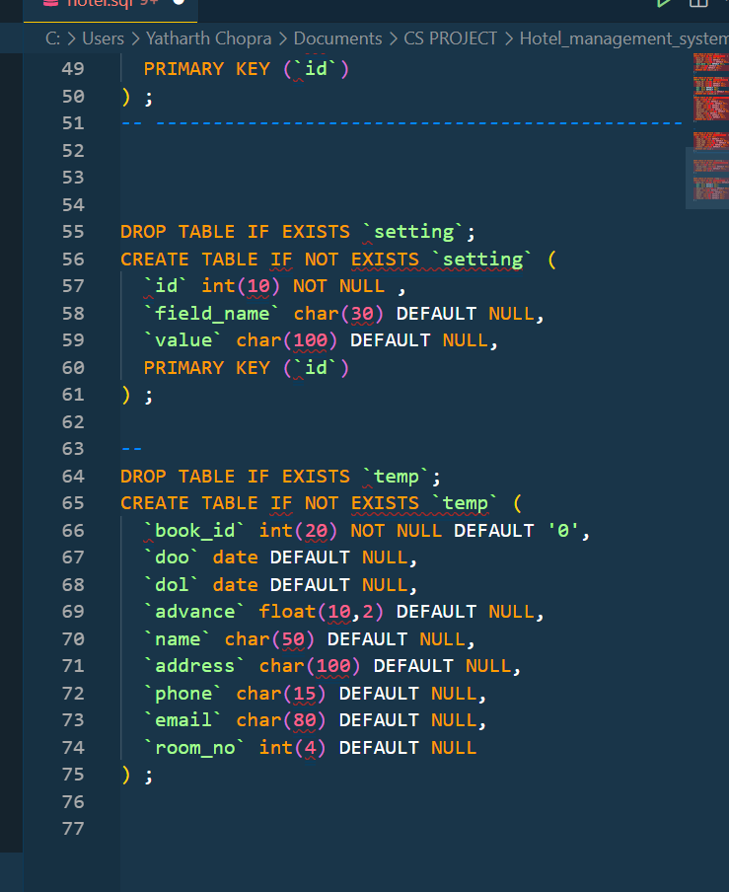
BACKEND SQL CODE

Slide 8
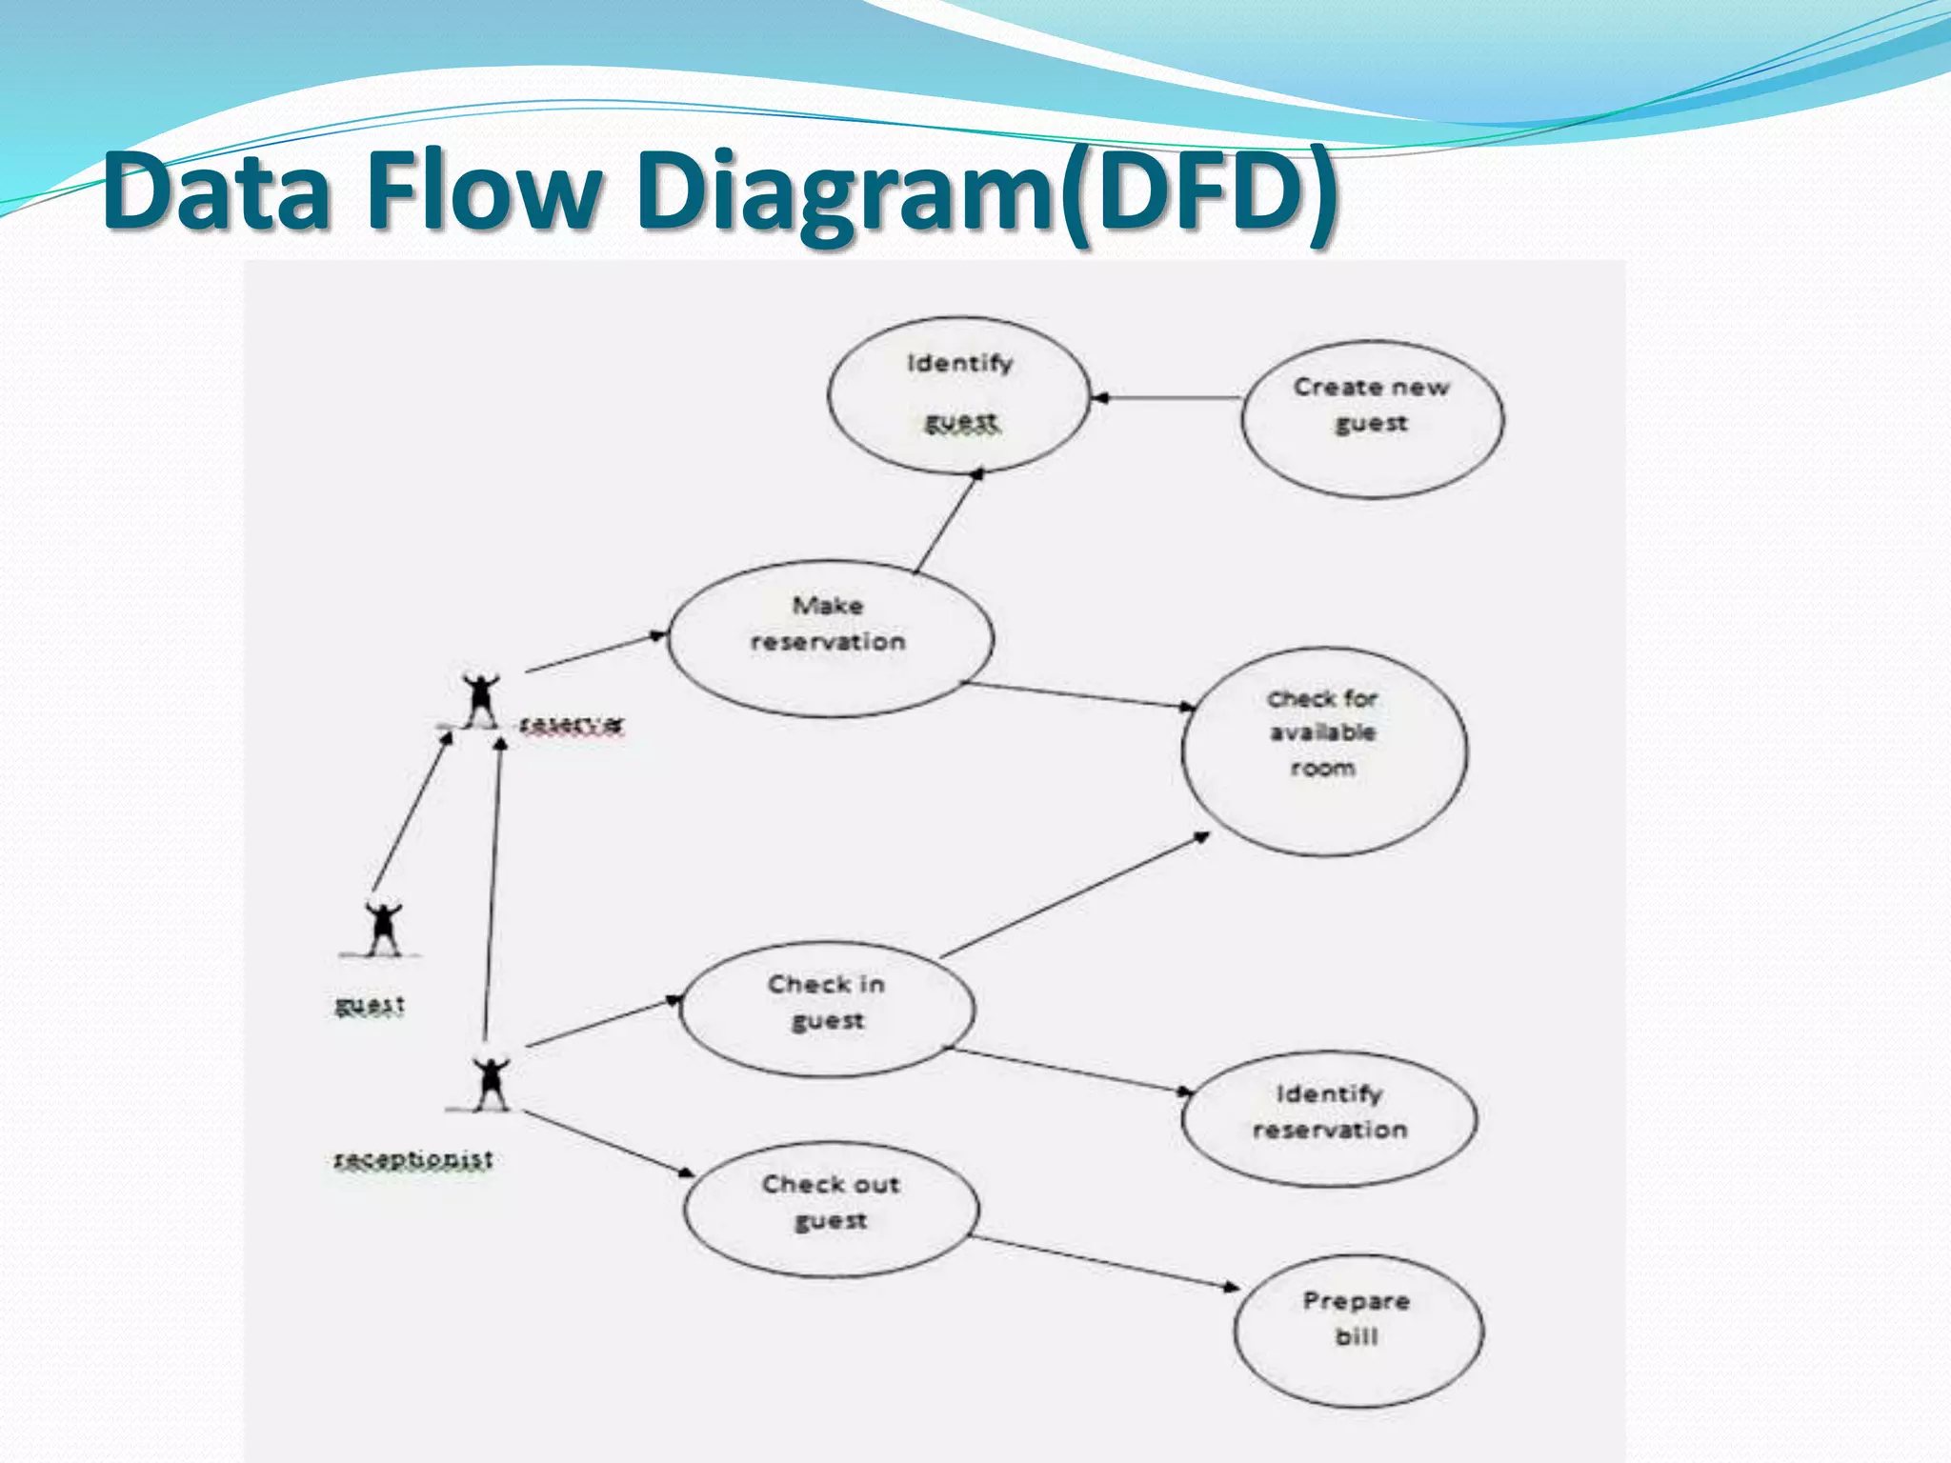
Front End details
DATA FLOW DIAGRAM

Slide 9
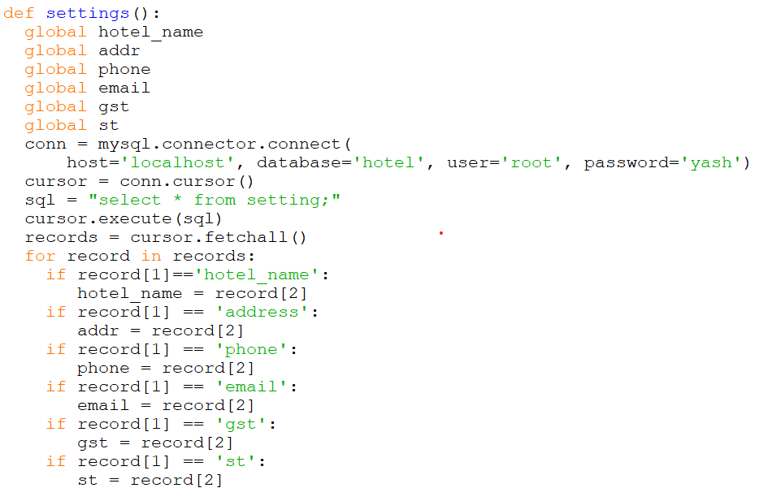
FUNCTIONS FOR SETTING

Slide 10
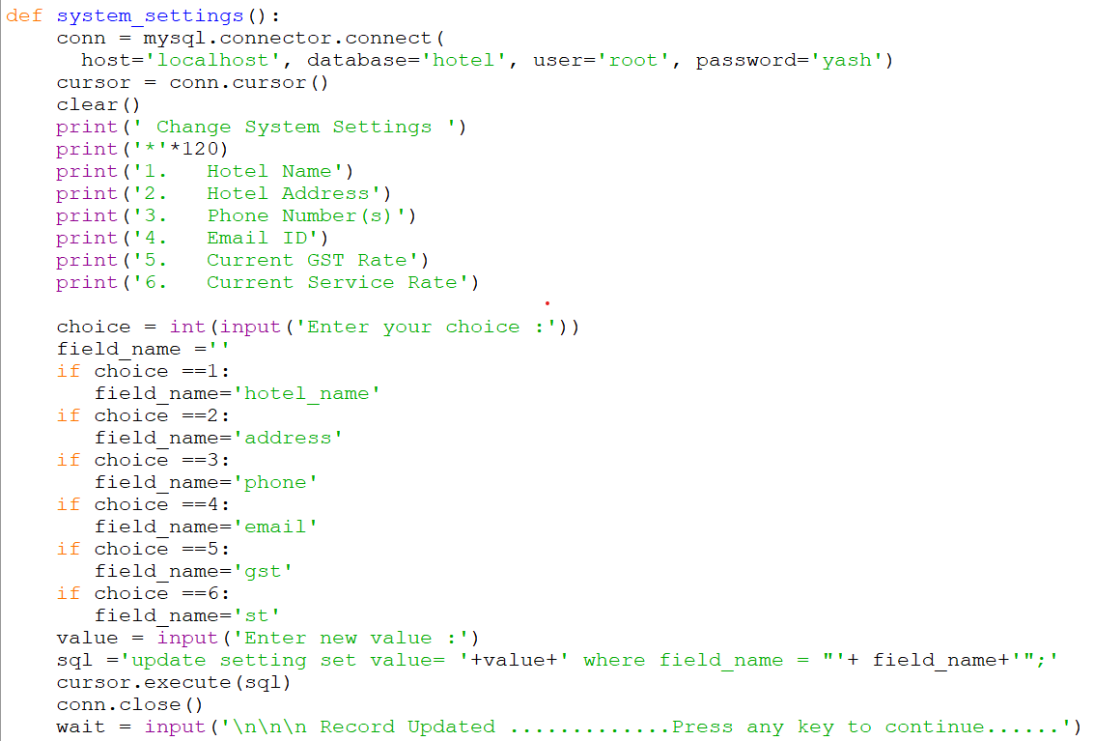
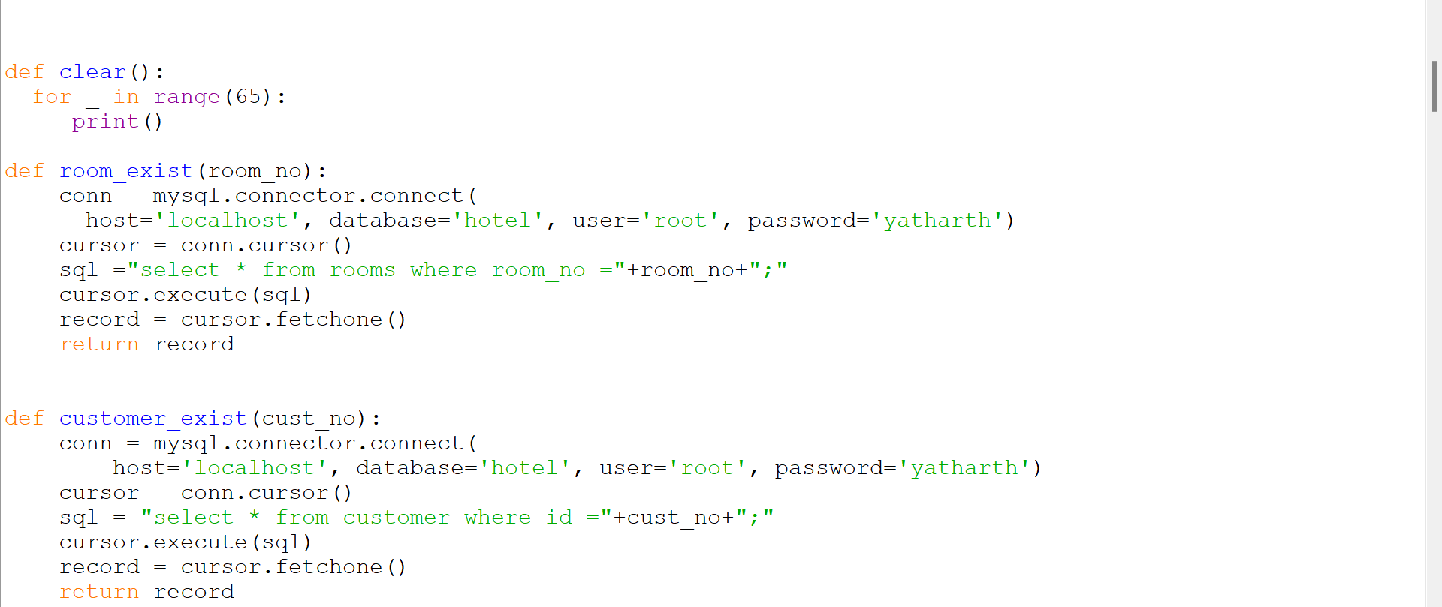
FUNCTIONS FOR SYSTEM SETTING

Slide 11
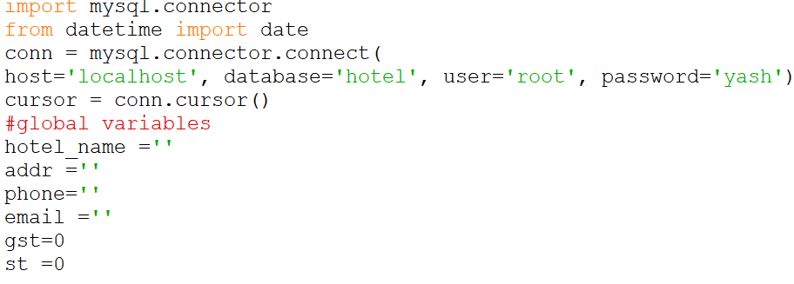
IMPORTING FUNCTIONS IMPORTING FUNCTIONS

Slide 12
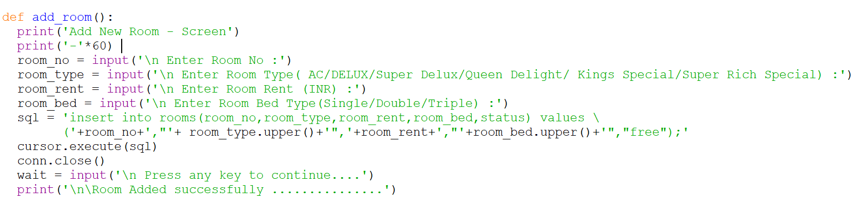
FUNCTIONS FOR ADD ROOMS

Slide 13
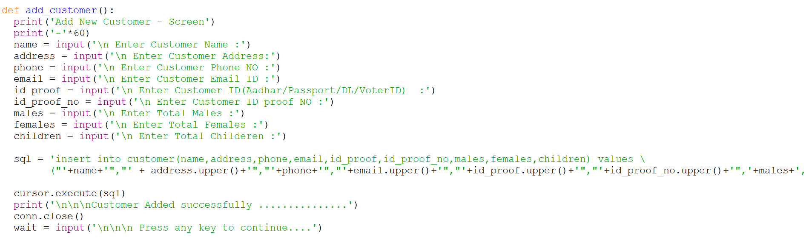
FUNCTIONS FOR ADD CUSTOMERS

Slide 14
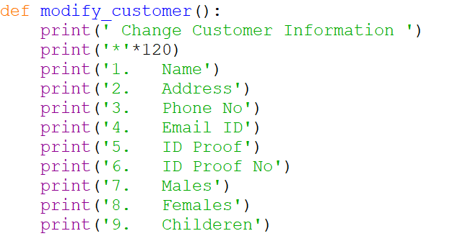
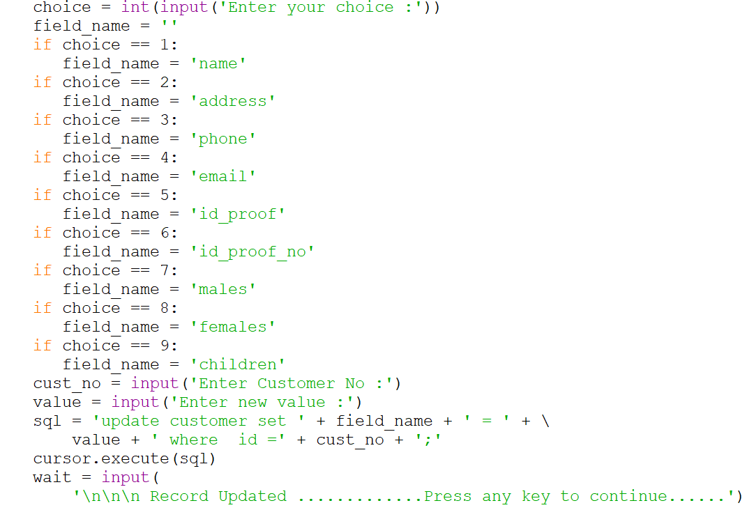
FUNCTIONS FOR MODIFY CUSTOMERS

Slide 15
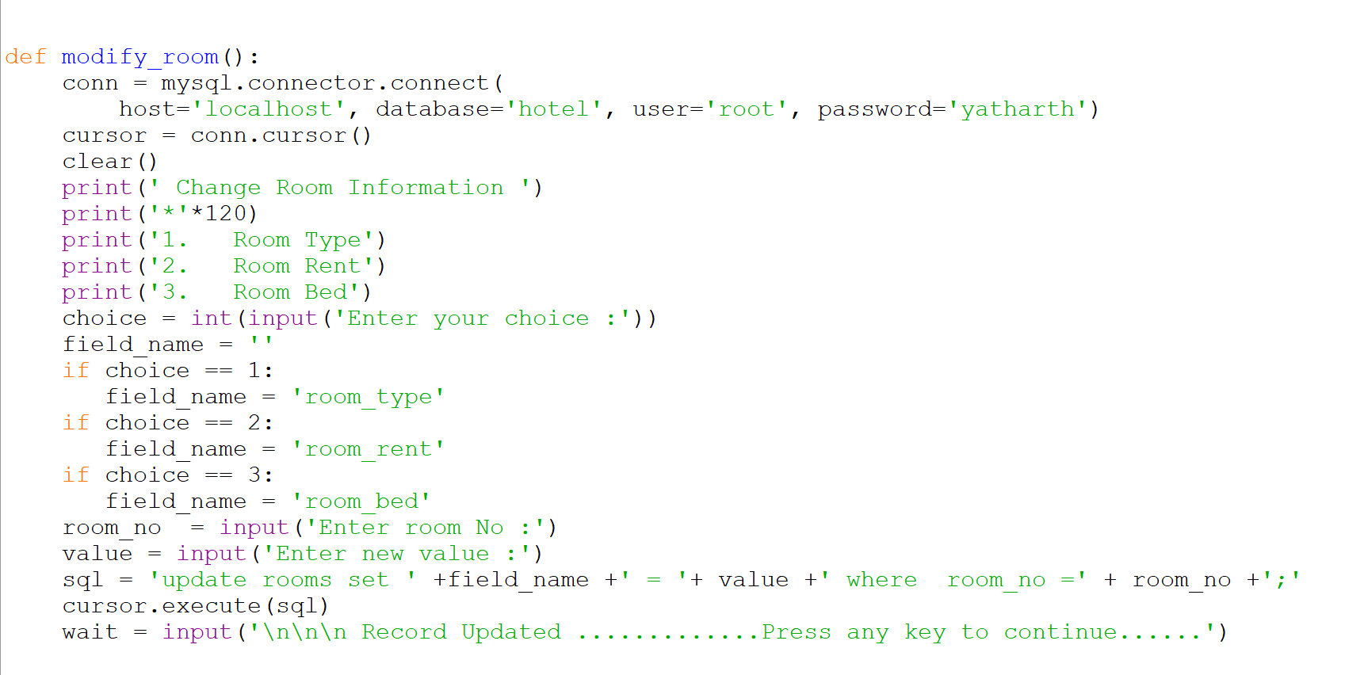
FUNCTIONS FOR MODIFY room

Slide 16
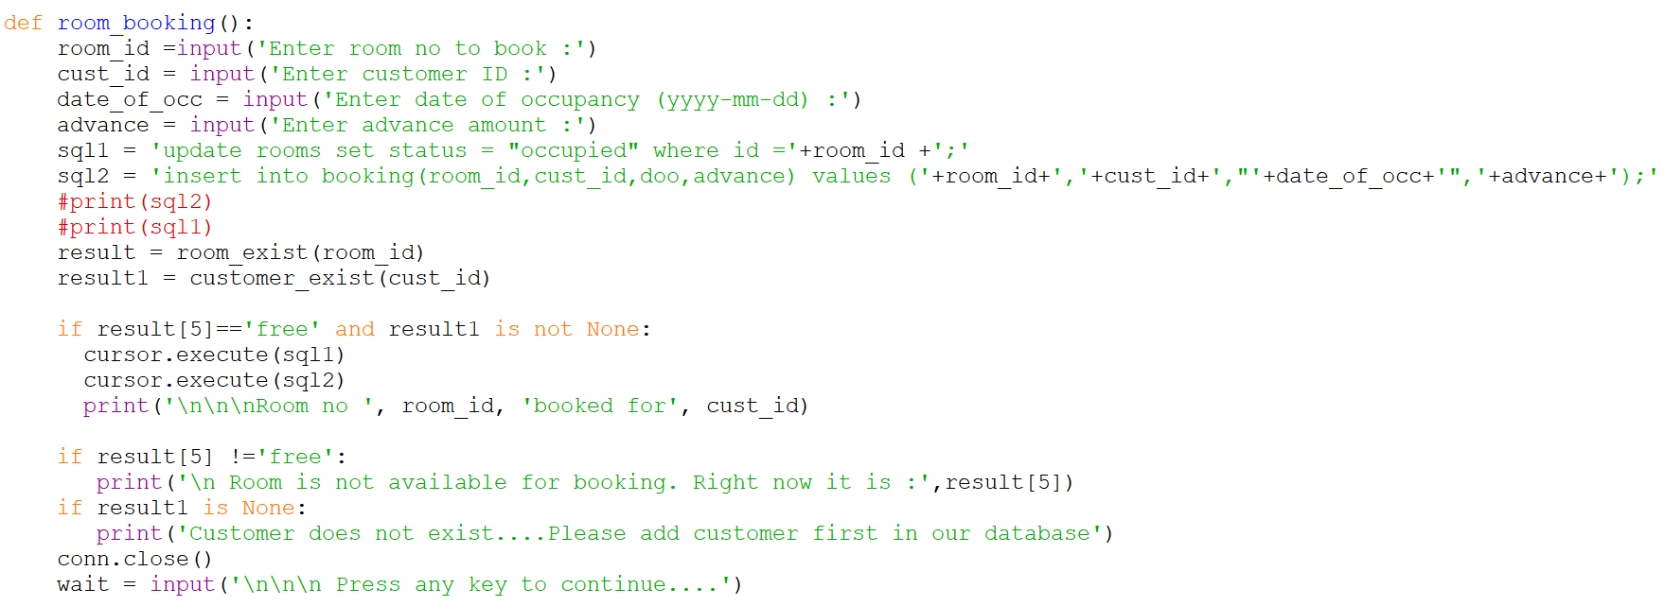
FUNCTIONS FOR ROOM BOOKING

Slide 17
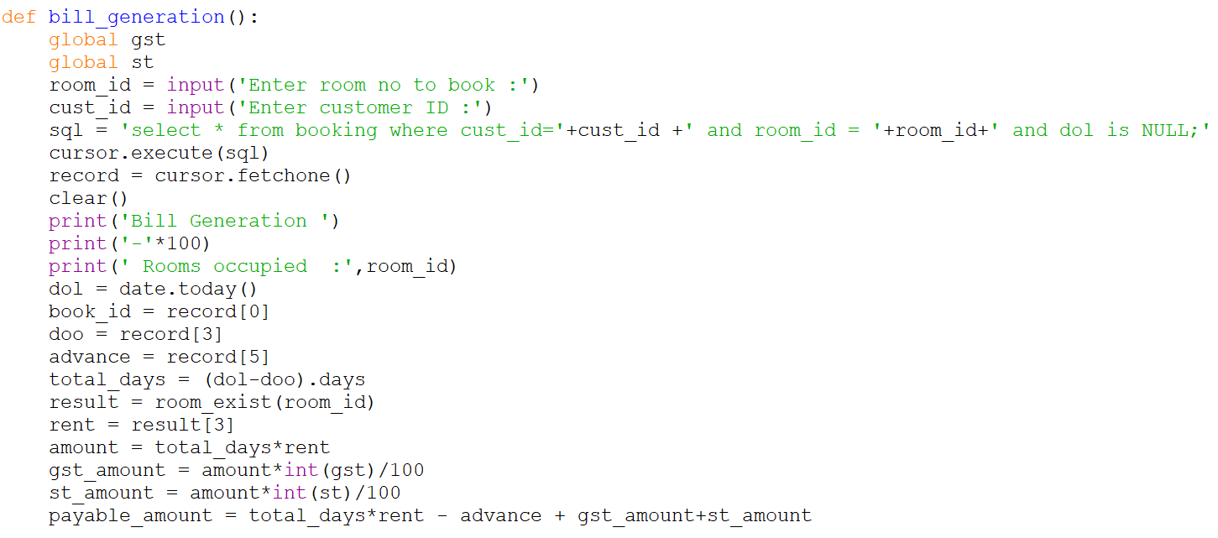
FUNCTION FOR BILL GENERATION

Slide 18
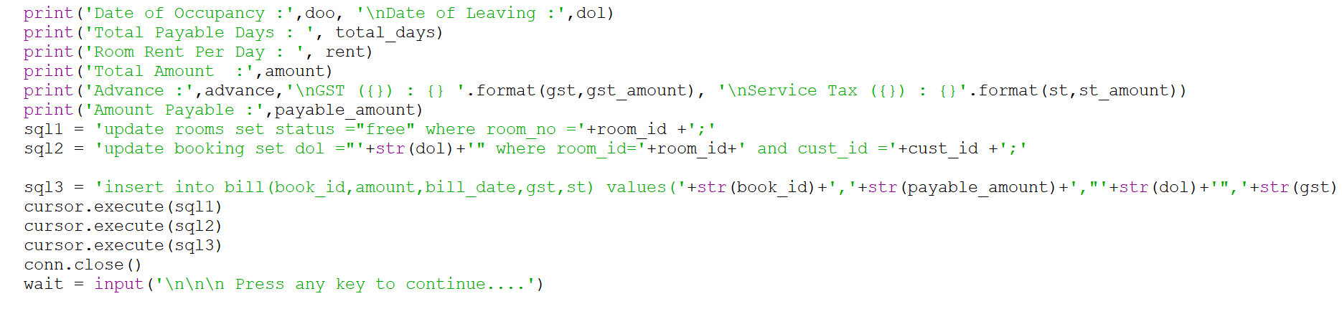

Slide 19
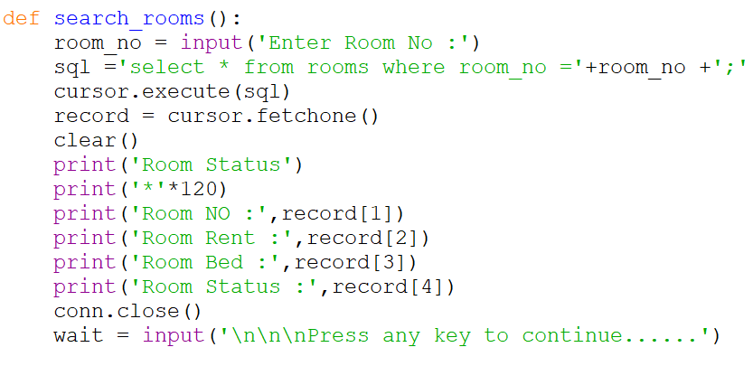
FUNCTIONS FOR SEARCH ROOMS

Slide 20
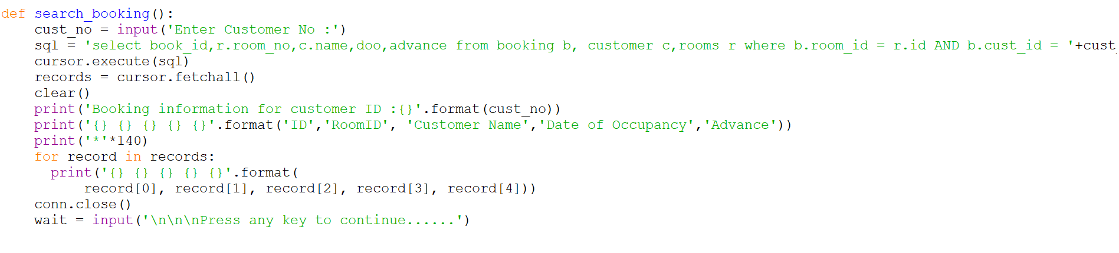
FUNCTIONS FOR SEARCH BOOKING

Slide 21
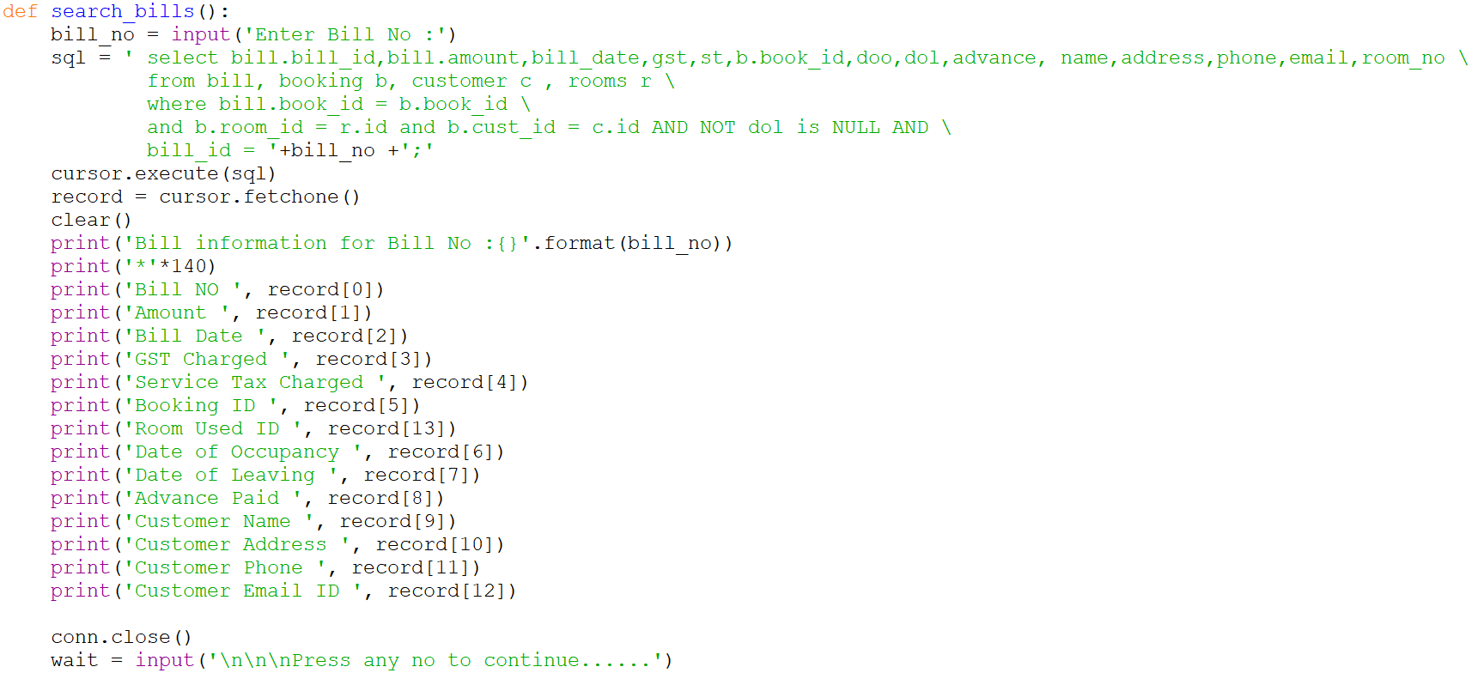
FUNCTIONS FOR SEARCH BILLS

Slide 22
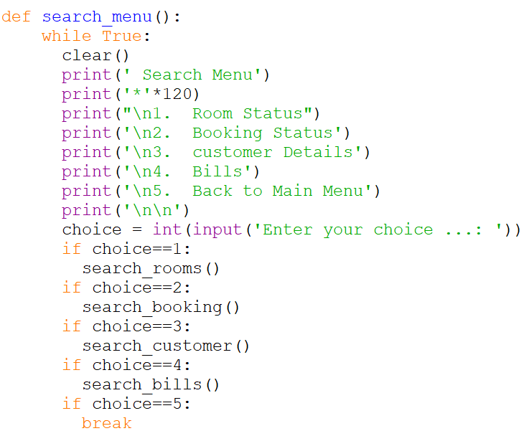
FUNCTIONS FOR SEARCH MENU

Slide 23
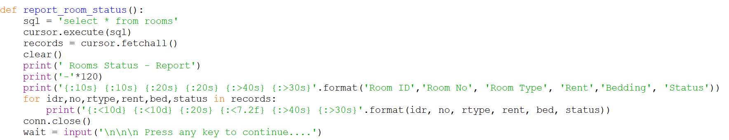
FUNCTIONS FOR REPORT ROOMS STATUS

Slide 24
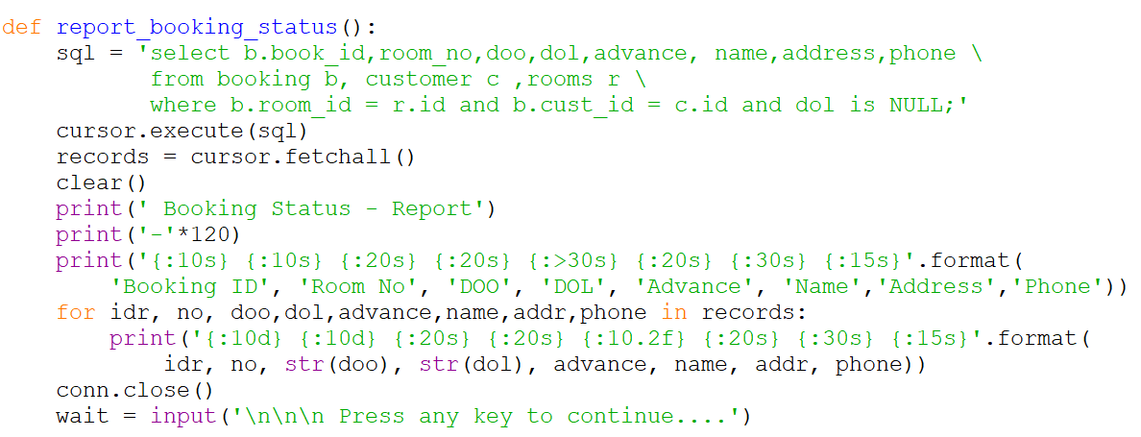
FUNCTIONS TO REPORT BOOKING STATUS

Slide 25
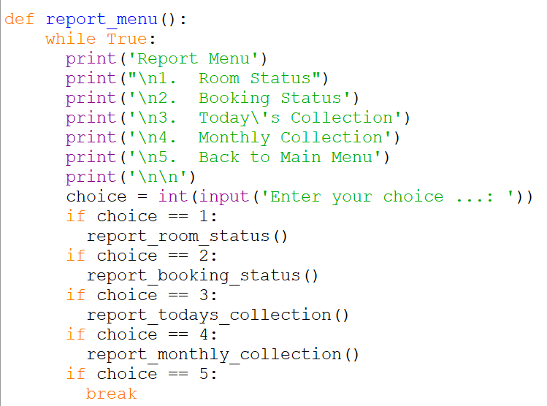
FUNCTION FOR REPORTING MENU

Slide 26
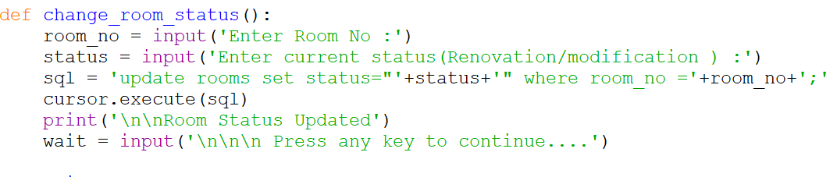
FUNCTION FOR CHANGE ROOM STATUS

Slide 27
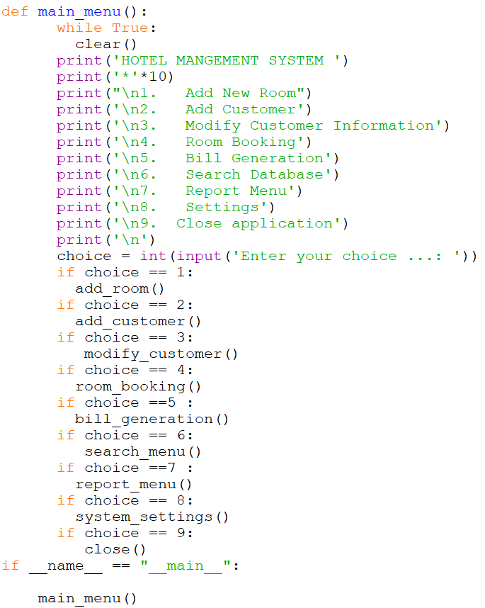
FUNCTIONS FOR MAIN MENU

Slide 28
FUTURE WORK AND UPGRADES in software
To make it more automated
To make it with GUI friendly
To make a log system
To make login rights and logins for separate Admin and Hotel workers .
Make it cloud based for upgradations and storage .

